Slide 1


Mobile Deep Learning Inference Framework for Android-Based Short-Circuit Trace Classification
Supervisor: Prof. Junho Bang
Presenter: Hadi Nazari
IT Applied System Engineering
2026

Slide 2

Table of contents
Introduction
Objective
Proposed System
Dataset & Preprocessing
Android Implementation
Model Conversion (TFLite)
Results
Application Interface
Advantages
Conclusion

Slide 3
Introduction
Electrical fires often caused by short circuits
01
• Need to distinguish PSCT vs SSCT
02
• Traditional methods are manual and subjective
03
• AI enables automated classification
04

Slide 4
Objective
• Develop Android-based classification system
• Use lightweight CNN models
• Enable real-time mobile inference

Slide 5
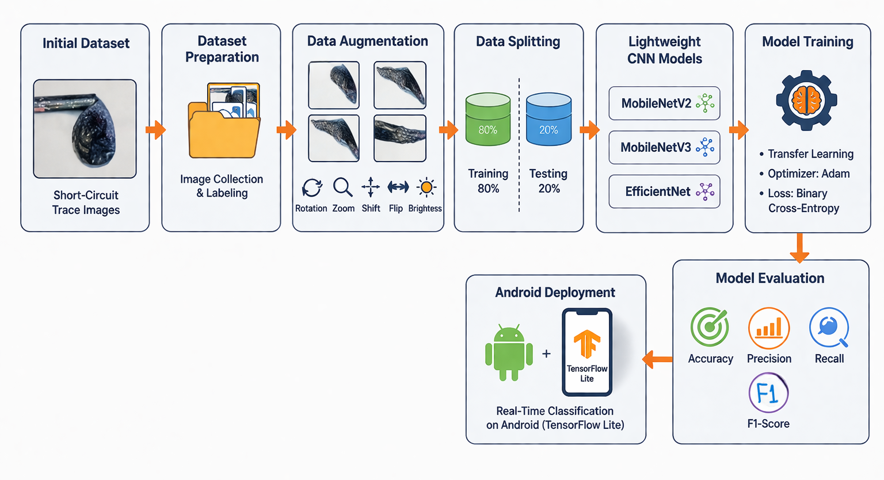
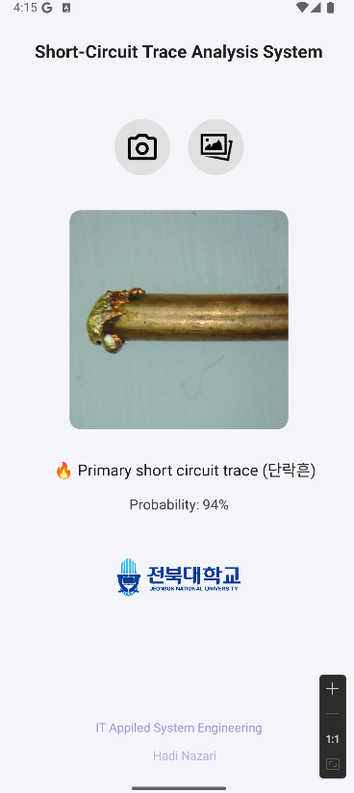
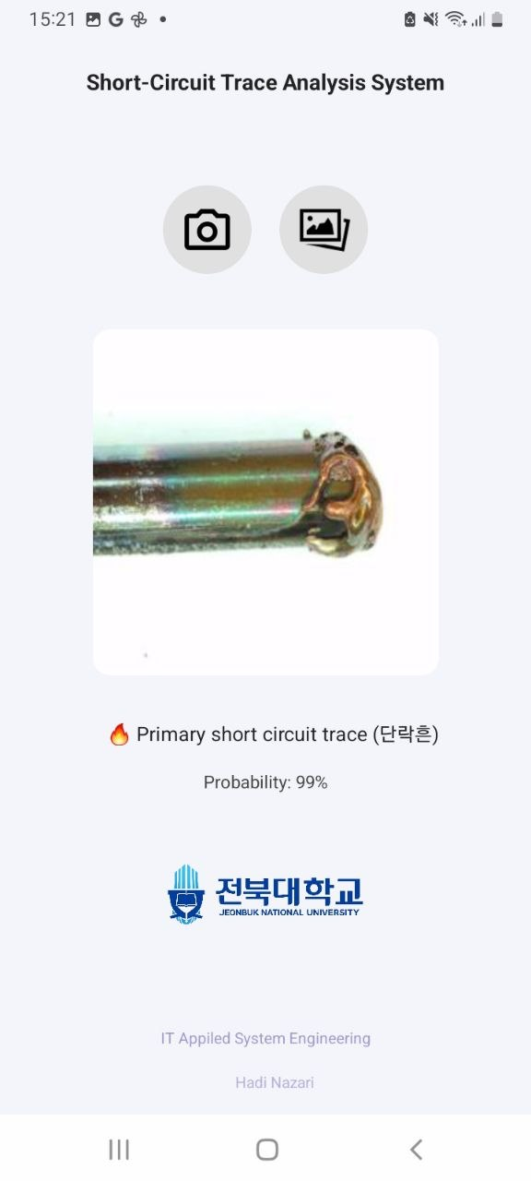
Proposed Framework for Electric Fire Short-Circuit Trace Classification

Slide 6
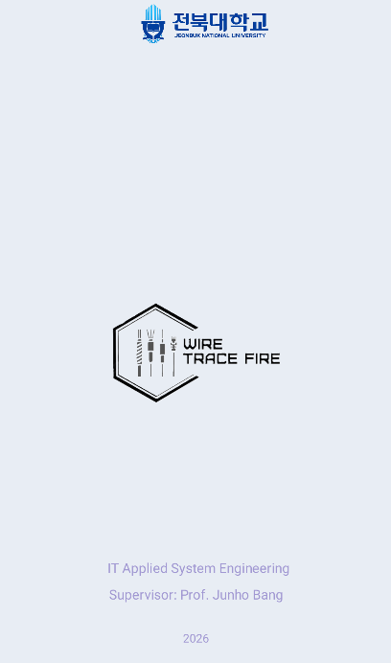
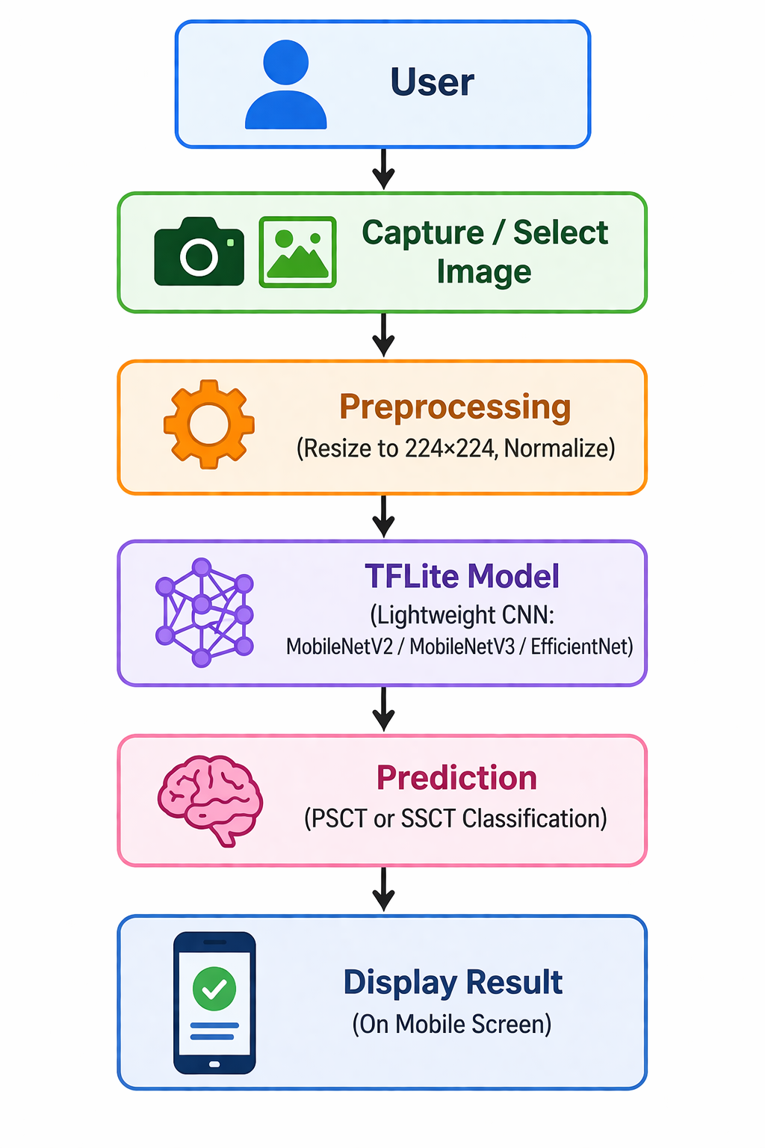
Android System Overview

Slide 7




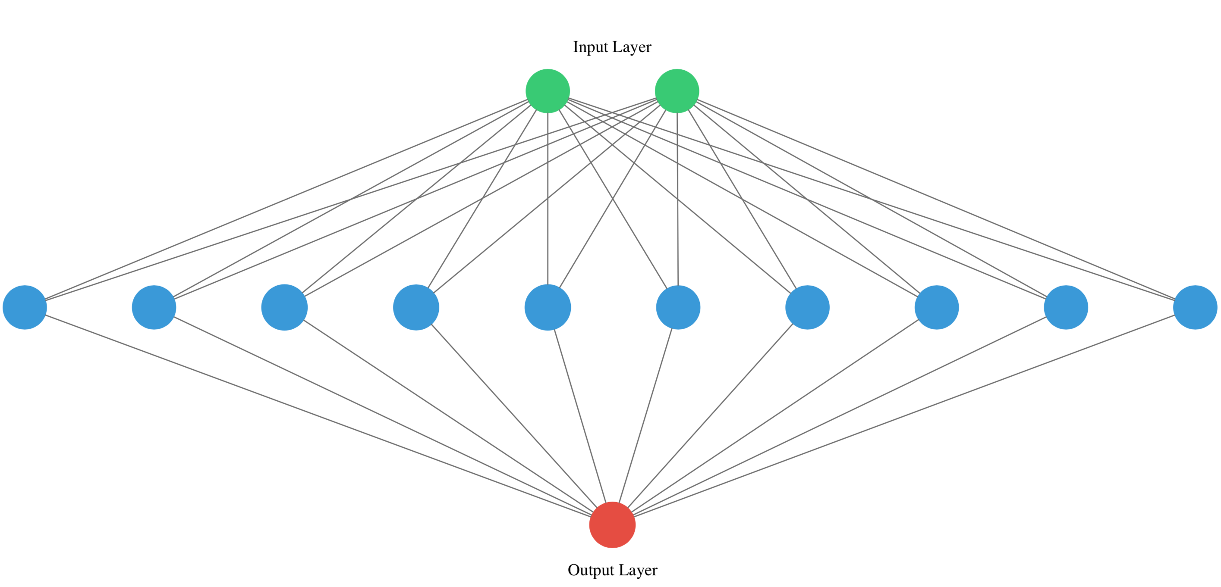
Android Implementation
The mobile application was developed using:
Java
Android Studio
Model trained in Python (Anaconda, TensorFlow)

Slide 8
Dataset
Total images: 752
• Classes: primary short-circuit traces (PSCT), secondary short-circuit traces (SSCT)
• Split: 80% training, 20% testing
• Augmentation: rotation, zoom, flip, brightness

Slide 9
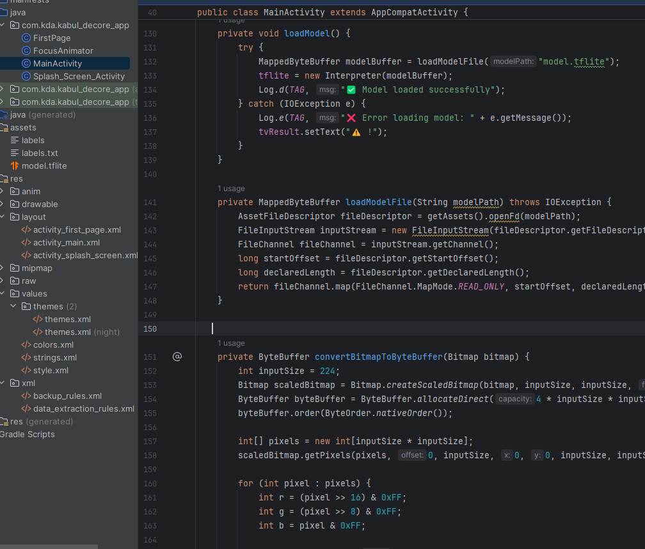
Preprocessing
Input image resized to: 224 × 224 pixels
Converted into ByteBuffer format
Pixel normalization applied for model compatibility

Slide 10
Model Conversion (TensorFlow Lite)
After training, the best-performing model was converted to TensorFlow Lite (.tflite) format.
This step enables:
Reduced model size
Faster inference
Compatibility with mobile devices

Slide 11
Inference Process
Input image converted into numerical tensor
Model outputs a probability value:
< 0.5 → PSCT
≥ 0.5 → SSCT

Slide 12
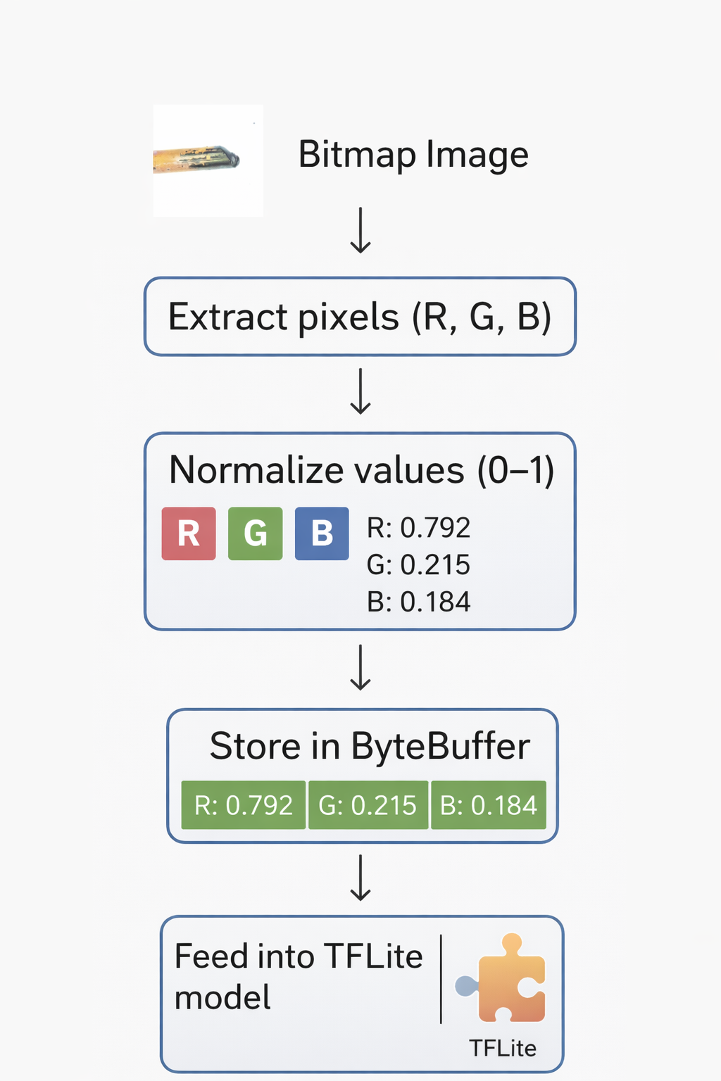
ByteBuffer
A memory container for raw numerical data
TensorFlow Lite understands only numerical arrays (tensors).
TensorFlow Lite requires input in this form because:
It is fast
It is low-level (close to hardware)
It avoids extra memory copying

Slide 13
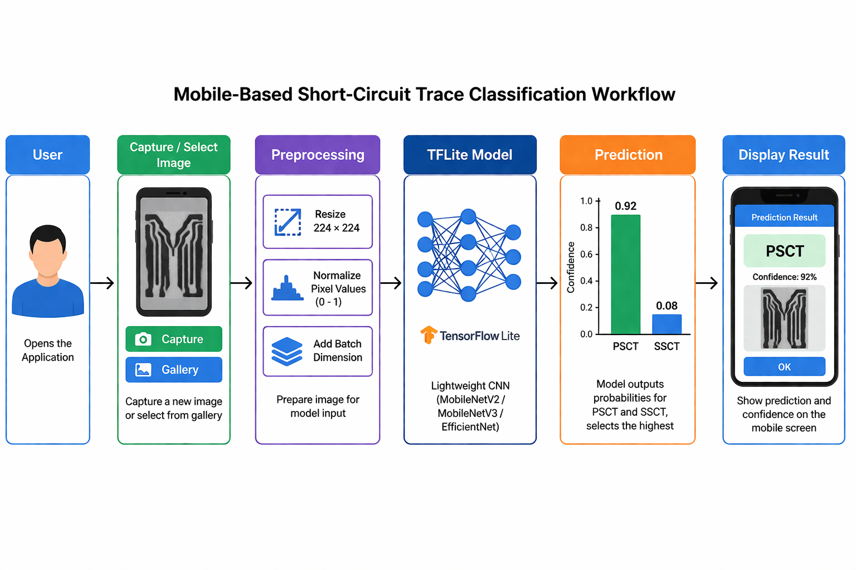
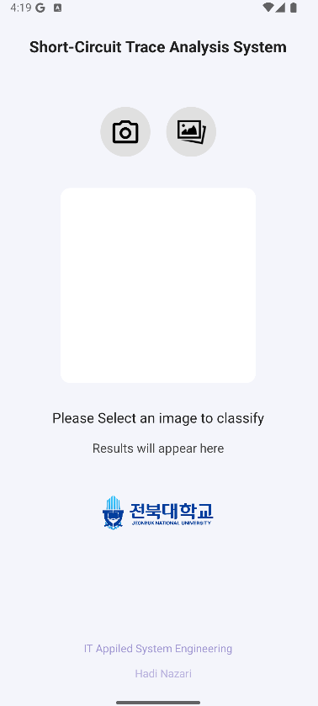
System Overview
0.94
0.06

Slide 14
Results
EfficientNet: 96.05% accuracy
• MobileNetV3: stable performance
• MobileNetV2: efficient and fast

Slide 15

Application Interface
Image input (camera/gallery)
• Prediction result
• Probability output
• User-friendly UI

Slide 16




Advantages of the Mobile Implementation
Real-time classification
No internet required (on-device inference)
Lightweight and efficient
Suitable for field use (fire investigation)

Slide 17
Summary
Model trained in Python (Anaconda, TensorFlow/Keras)
Converted to TensorFlow Lite format
Integrated into Android Studio (Java)
Supports camera & gallery input
Performs real-time on-device classification
Displays predicted class and confidence

Slide 18

Future Work
Expanding the dataset to improve generalization
Enhancing accuracy using advanced models
Improving the user interface with better graphics and usability
Adding more features for practical and flexible use

Slide 19
Thank you

